Slide 1

COMP6441 Project
Student Cybersecurity Password Survey
Name: Chaofan Xu
zID : z5563464
Date : 25/7/25

Slide 2
CONTENTS PAGE
P1.Intro
P2.Key Findings
P3.What I Did?
P4.Challenges

Slide 3
Intro

Slide 4
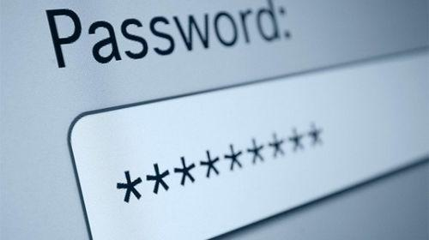
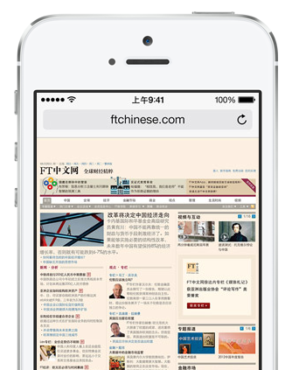
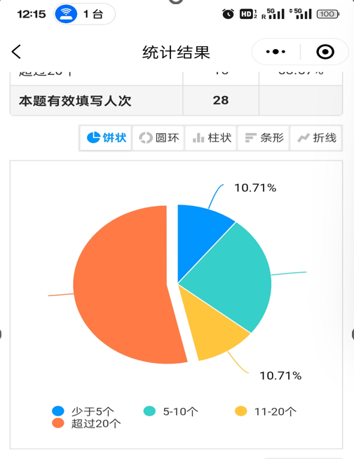
Intro
Do we really understand what makes a password secure?
How do students actually create and store their passwords?
How can we improve our password
habits?

Slide 5
Key Findings

Slide 6
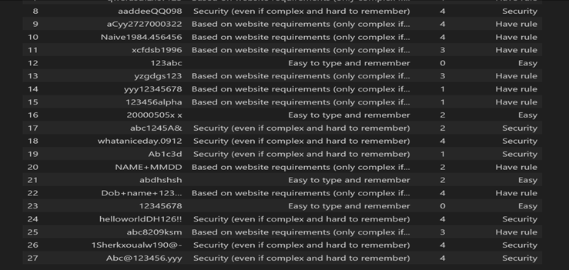
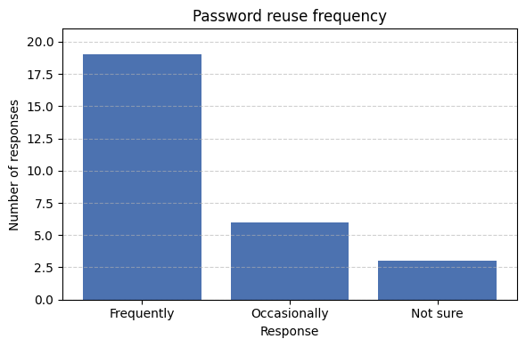
Key Findings
🔎 Course Links:
Week 2: Human factors in security
Week 3: Entropy
Week 4: Usability-security tradeoff
Some passwords looks complex but actually are very weak.🔓
Most students reuse passwords frequently and still rely on memory.🧠
Most students rarely use password management tools
High-scoring passwords can still be insecure.❗
There’s a big gap between how we think about passwords and the
actual risks.🌉
Rule-following ≠ real security Absence of leaks doesn’t equal safety

Slide 7
What I Did?

Slide 8
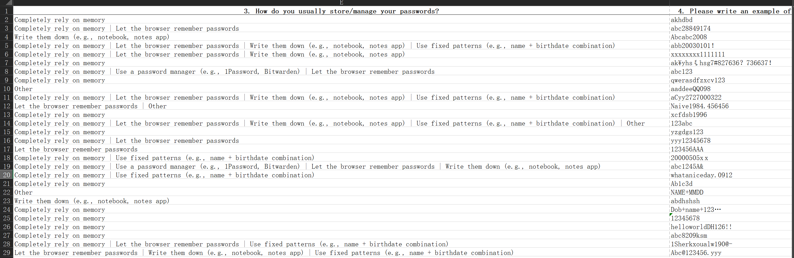
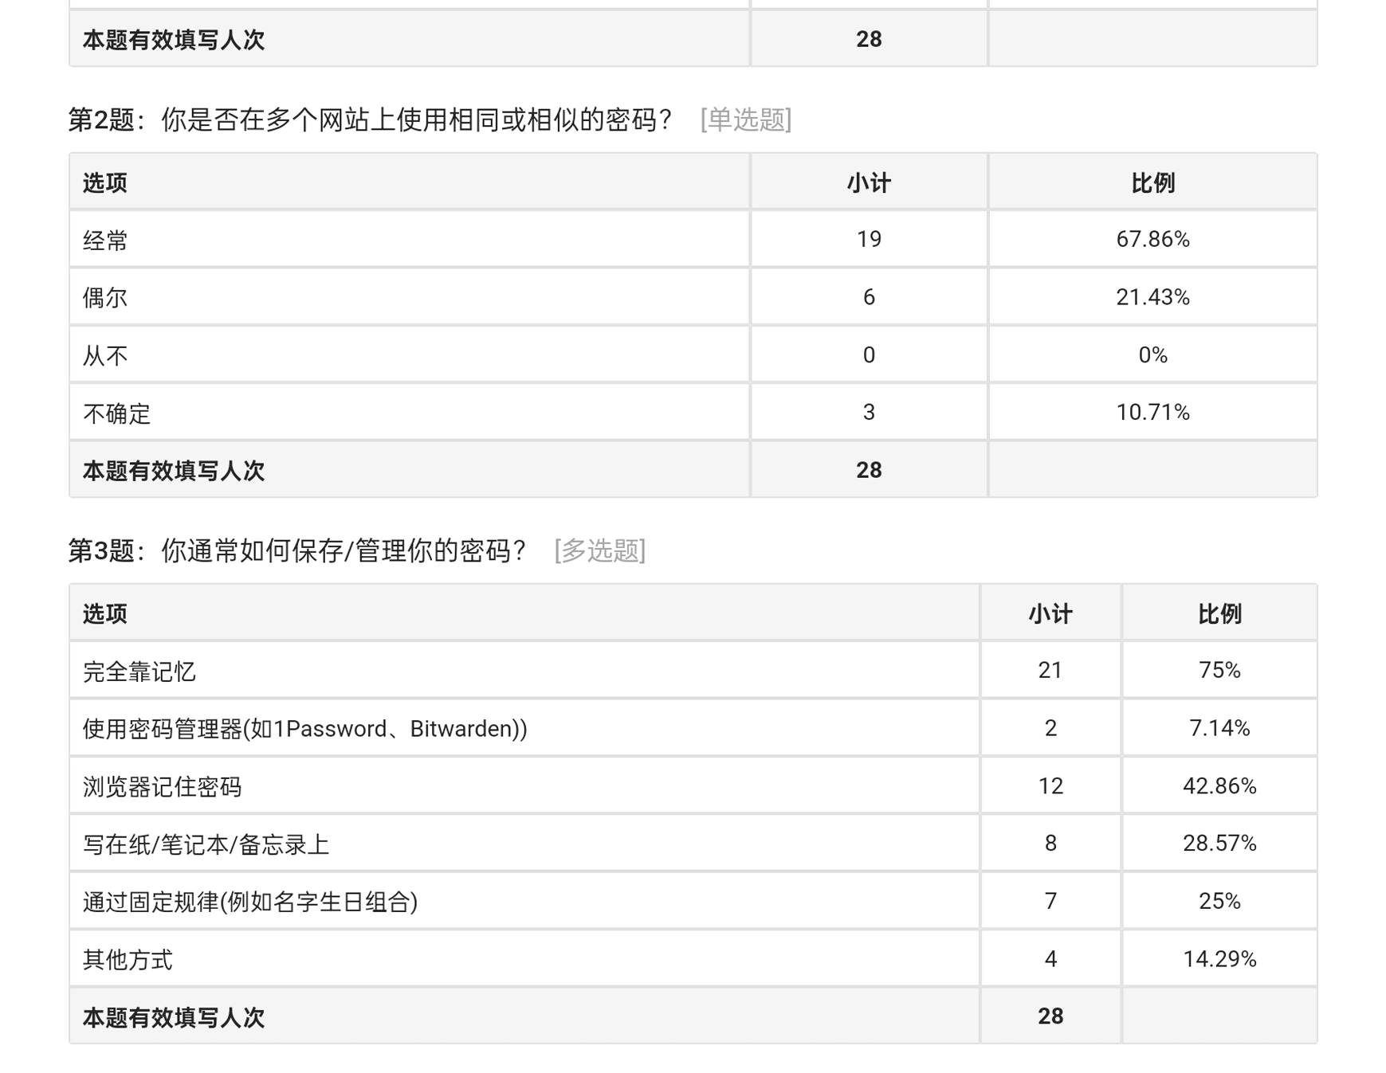
Basic Information (Excerpt)
Step 1
Designed survey
Step 2
Collected Data
Distribute questionnaires
Cumulative received: 28
Region: Australia、China、USA
Mostly effective

Slide 9
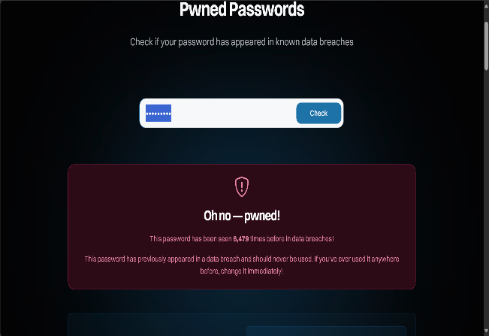
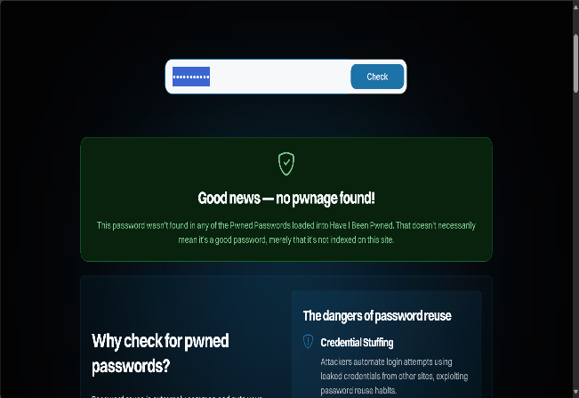
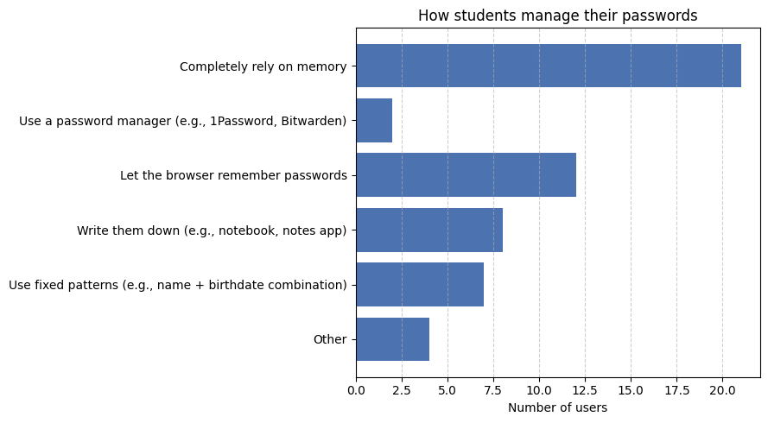
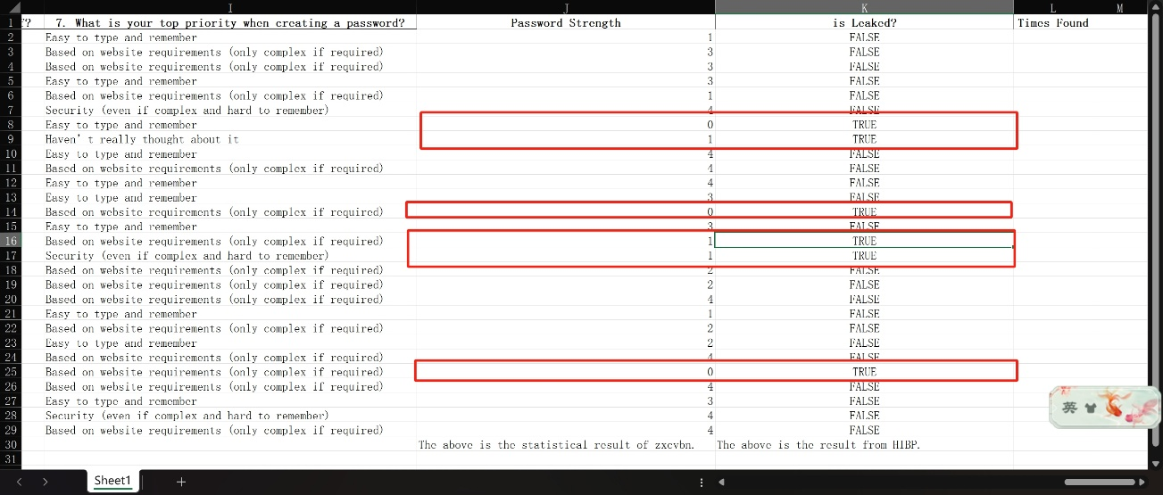
Step 3
Analyzed structure & Created visualizations
I have created many user behavior analysis charts similar to the one shown above. The results are clearly visible.
I also conducted a cross-analysis of password strength and whether it was leaked.

Slide 10
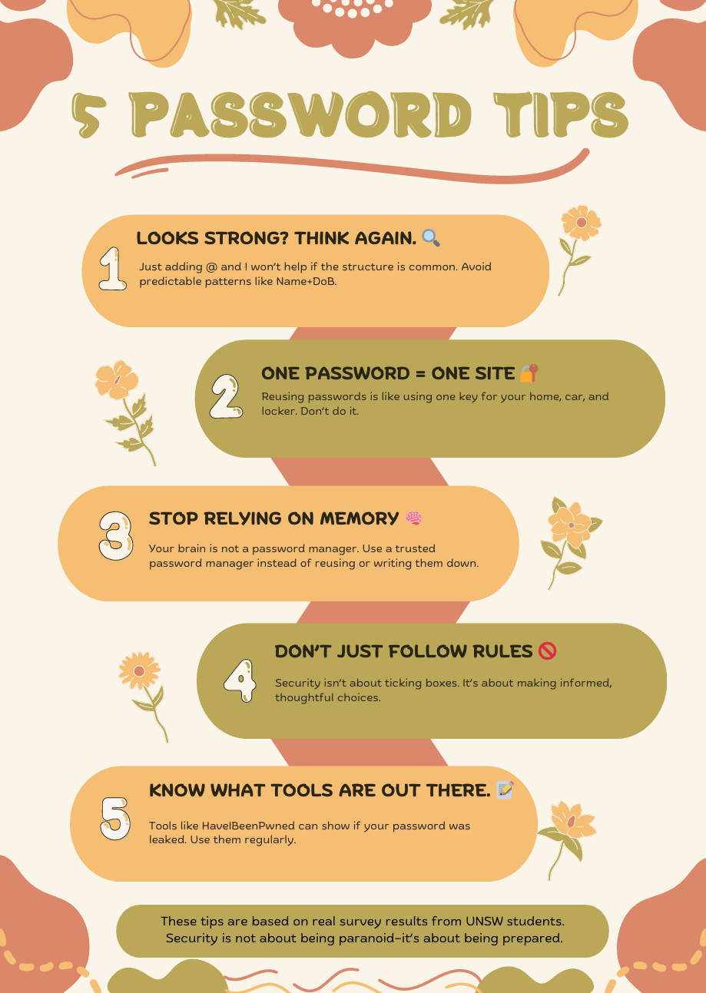
Step 4
Wrote the main part of the report
Then sort out the data, prepare the text manuscript and create the video.
Step 5
Designed a practical tip poster
This poster encapsulates the core findings of this research.
“Looks complex” isn’t always strong
Dont reuse passwords
Stop relying on memory
Don’t just follow rules
Learn to use security tools

Slide 11
Reflection and Challenges

Slide 12
Thank you for watching!

